Slide 1
TopBuild Inc.
Timothy O’Brien

Slide 2
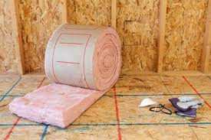
TopBuild Inc.
TopBuild is the largest purchaser, installer, and distributor of insulation in the United States of America.

Slide 3
TruTeam & Service Partners
TruTeam is involved in the business aspect that takes care of; material procurement, project scheduling and logistics, multi-phase professional installation and installation quality assurance.
Service Partners deals with the distribution aspect of the company. When it comes to the leading distributor of insulation, Service Partners has built 70 distribution centers in which they are able to move insulation around the country at a much faster rate than any of the competitors competing with TopBuild.

Slide 4
Location of Branches

Slide 5
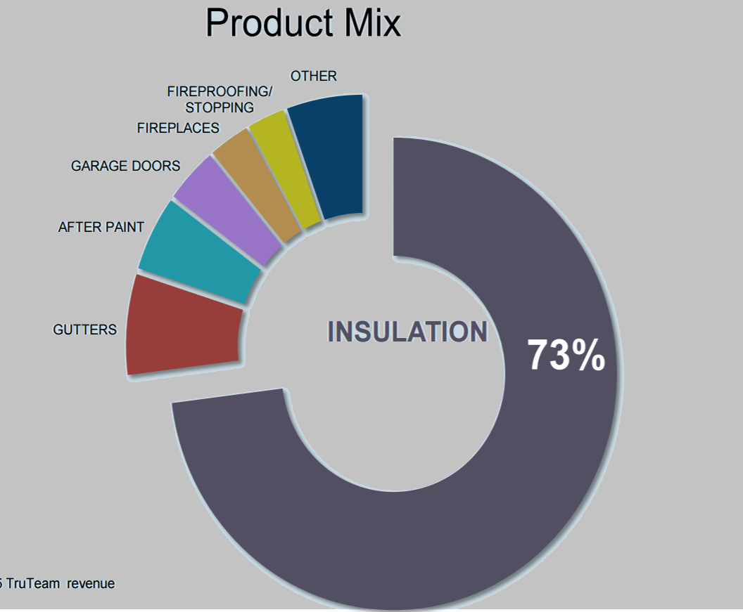
TruTeam Product Mix

Slide 6
Service Partners Product Mix

Slide 7
Commercial Share: Light, Large, Heavy
Light: Retail, Hotel, Education, Small Offices $2,000-$50,00
Large: The bridge between light and heavy commercial project $50,000-$200,000
Heavy: Hospitals, Arenas, Universities $200,000→

Slide 8
Energy

Slide 9
Energy Efficient Codes
New Codes require better insulation which TopBuild provide builders.

Slide 10
Winner of the Energy Star Award
3X Winner

Slide 11
Important Numbers

Slide 12
Total Assets vs. Debt (In Thousands)
Total Assets- $1,642,249 vs Total Debt- $193,457

Slide 13
Projected Growth 2016-2020
Net Sales- $1,665,077-$1,874,059
Free Cash Flow- $44,957-$50,599
Gross Income- $361,321-$406,670
NOPAT(Earning before interest and tax)- $234,859-$264,336

Slide 14
TopBuild’s Balanced Capital Allocation Plan

Slide 15
Accretive/Strategic Acquisitions
Residential New Construction
Focus on more Commercial Projects

Slide 16
Return of Capital
Implement a $50 Mil. Share Repurchase Program

Slide 17
Competitive Advantage
1.) Upper management strength
2.) No restrictions on customer size or location
3.) TruTeam and Service Partners accessibility
4.) Projected Growth
5.) Number one in Insulation Instillation/Delivery/Buying

Slide 18
Overview
With the help of TruTeam and Service Partners, TopBuild Inc. will be able to provide positive returns for those who choose to invest in the flourishing sector of the insulation business. With its competitive advantage and the work in the future it will be a bright future fro the company as a whole.

