Slide 1
FB, BUY, $130 Target Price April 18, 2016
Mike Swierczek, CFA mswierczek@gmail.com

Slide 2
FB: The Bull Case
Scale, Use and Growth of Core Social Network
Massive social network, network effects with billions of users create high barriers and very wide, defensible moat
Very large economies of scale create high margins
Intensity of use remains very high (~80% US) , eyeball share growing: minutes/user +22% y/y.
Built for the mobile world and has successfully navigated mobile transition (80% of ad rev)
Future Opportunities Stemming From The Core
User data, analytics, measurement (FB pixel, Conversion Lift) lead to improved quality and relevance in ads. FB Audience Network (3rd party sites) now $1b run rate
Better monetize supplemental products:
Instagram: 400m MAU, recently added Trending Content, content editing apps
Messenger: 800m MAU, “M” AI, payments
WhatsApp: 1b MAU, now free
Virtual reality option: Oculus the leader in VR, future platform opportunity
Monetization/minute spent by users still well below comps
Prevalence of improving ad blockers further increase value of contained ecosystem
Online video offers huge potential, now at 100m hours daily. Slideshow: video ads at low connection speeds

Slide 3
Risk Exists, But Trumped By Opportunities
Contrarians Argue | Counter Argument
Are young people shifting more to other sites? | Some risk here, but little evidence that this has effected growth, scale, or usage. May also become users as lifestyle changes with age. Instagram skews younger.
Law of Large Numbers will catch up to it (1.6 b MAU) | True, it will eventually catch-up to it, but still growing users +14% y/y and reaccelerated in 2H15, faster than most peers. FB has faced this for years, still growing.
Regulatory/privacy risk | Some risk here, but nothing appears imminent that would drastically impact business
Advertising effectiveness uncertain | Risk has significantly diminished in recent quarters, with introduction of FAN, better analytics, new products, etc
Huge portion of NPV FCF calculation is tied to terminal value assumptions | Very profitable high growth companies inescapably tied to growth assumptions, but appears to have a long, clear road ahead of it with a very wide moat.

Slide 4
Much More Growth To Come
Phase III: New Platform Opportunities
Virtual Reality: Oculus top of my VR Leaderboard
Deepen Instagram (400m MAU), WhatsApp integration
Exploit “walled garden” of search
Substantial online video opportunity (100m hours watched daily now)
Phase II: Monetize Users
Domestic Market now >$40 ARPU 4QT, growing 50% y/y
Substantial International opportunity: $7 ARPU, +25% y/y
Revenue/user minute still well below comps, lots of room to rise
Treasure trove of user data, 3rd party advertising (FAN)
2.5m active advertisers, >50m small business pages
FB is only
about here
Phase I: Add Users
1.6 billion global MAU
Global MAU still growing +14% y/y
Near 60% share of smartphone installed base
Slowing device markets as market saturates creates headwind
Very strong intensity of use still rising: ~80% domestic, 2/3 global DAU/MAU
Illustrative, not drawn to scale

Slide 5
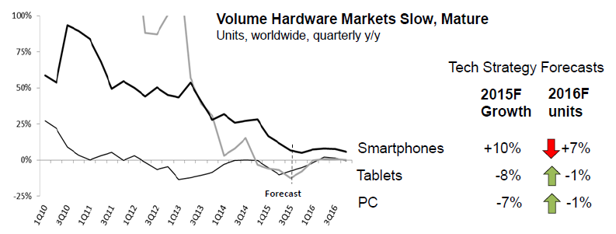
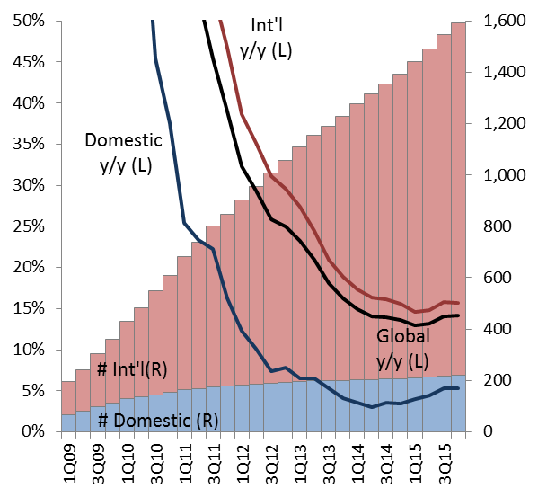
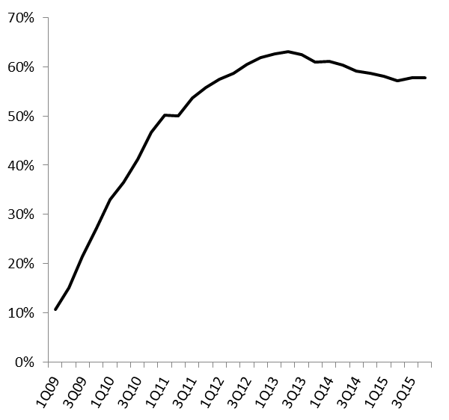
Stage I: Nearing an End. Device, FB Penetration High
The market is becoming saturated as the world is running out of people without a smartphone, tablet or PC that can afford one, and FB’s penetration is nearing saturation among those users.
User Growth Continues, Some Reacceleration
Monthly Active Users (MAU)
Extremely High Mobile Penetration Has Stabilized
FB Mobile Users as a Share of Estimated Global Smartphone Installed Base
Source: FB, IDC, Gartner, my estimates

Slide 6
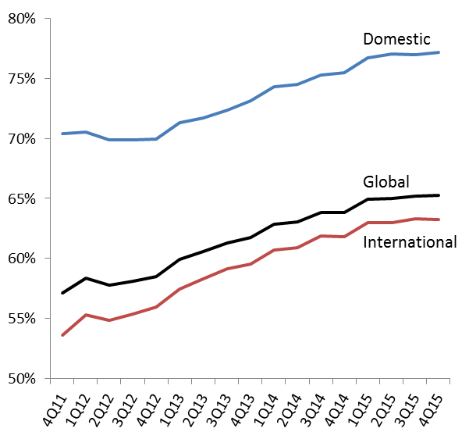
…But Intensity Mitigates, Leading to Stage II Growth
Ample opportunity remains within FB’s users to drive more revenue. Intensity of use continues to rise, with nearly 80% of domestic monthly users active daily, and nearly 2/3 internationally. FB faces more competition in international markets, but should be able to continue to grow user activity.
Near-term growth drivers:
Ad supply (users, more spaces, minutes) and demand (2.5m small businesses) are growing. Price/ad up 21% y/y in 4Q, impressions +29% y/y
Aggressive, constantly introducing new ad products
Shopping/’buy’ buttons
Instagram ads increasing
Oculus launch
Analytics/brand measurement, “Brand Awareness Optimization”
Intensity Increases Are Slowing, But Still Grows Higher
DAU/MAU
Source: FB

Slide 7
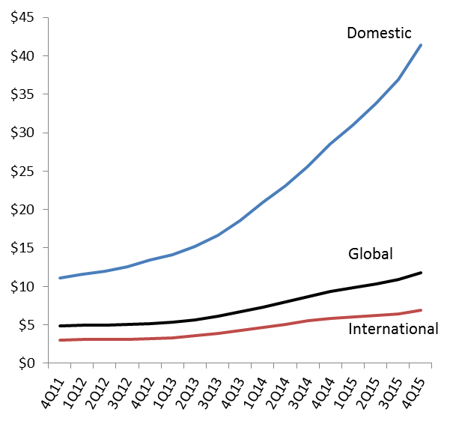
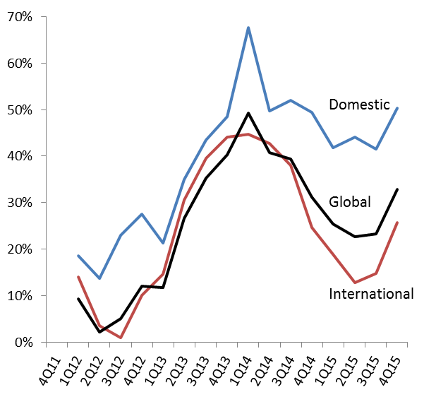
Stage II: Monetization Improves, ARPU Accelerates
Monetization is improving as FB continues to introduce new and better ad products, analytics, and even moves to third-party ads (FAN)
Improvements have led to a reacceleration in ARPU in recent quarters. ARPU is now growing 50% y/y domestically, and >30% globally. While the International ARPU won’t equal domestic, there is opportunity to narrow the gap in out years, especially as domestic growth slows.
$41 Annual Domestic ARPU Drives Growth, Int’l Opportunity
ARPU, 4QT
ARPU Growth Reaccelerates Across Geographies
Y/Y Growth in ARPU
Source: FB

Slide 8
Stage III: Virtual Reality as a Strong Growth Driver
Virtual reality (VR) is more than just gaming, it is a platform with enormous potential for conveying and interacting with information across many large markets: Communication, Enterprise, Real Estate, Education, Health Care and many more.
Gaming will be central monetization point and drive eyeball share in the early going, but presents enormous potential for social networking/communication/sharing. VR is now emerging, but enthusiasm should be tempered for 1.0 versions that fail to adequately capture VR’s potential.
In 2016, I forecast 9m VR units for the market, with high growth potential. While SNE’s PS VR is underappreciated and has an advantage in Year 1 (installed base, gaming strength, cost), longer-term, FB’s Oculus has better product, vendor tie-ins (MSFT, Samsung), declining price, and social network backing.
Virtual reality can become “the most social platform.”
- Mark Zuckerberg, FB CEO at MWC 2/21/16
Swierczek’s Virtual Reality Leaderboard
Leaders | FB (Oculus) – Leading SW platform. Competitors playing catch-up. March release plagued by delays. $599 price plus ~$1000 PC too expensive. Est 1m units. Short-term hurdles: PC-cost, non-gaming co. Future Xbox-device? Tie-ins with Samsung, MSFT. Touch controller delayed as well. SNE – Gaming focus with strong base. Media assets. Unveiled early. 1H16 release? $399 price inline with expectations, but October release much later than previously expected. Expect >1m units. Underappreciated by Street: installed base, gaming co, cheaper all-in cost. Will lead early, but Oculus better long-term. Valve/HTC – Rave reviews, but likely to stay true to gaming niche. $799 price & April launch. Estimate <1m units in ’16 GOOGL – Will cast a wider net: Glass 2.0, Magic Leap investment, Android base MSFT – HoloLens in AR. AR may have a higher ceiling. Kinect a strong asset. Xbox #2 to SNE in console. Win 10 support helps, especially with Oculus Xbox controller and Valve. Likely very expensive initially ($3k SDK). Untethered is key. Samsung – Smartphone HMDs (Gear VR) are entry level, not captivating. HW-only is tough. Price drop to $99
Other Contenders | AAPL – Likely working on something. Can’t ignore. Defend/protect ecosystem. Acquisitions: Metaio, FlyBy Media, Faceshift, expert hires
 | Nintendo – Long history in VR gaming. Should put experience to work. Waiting on NX
 | AMZN – Wants Prime ecosystem. Huge VR/AR potential in consumer retail core

Slide 9
FCF Valuation Analysis Yields $130 Target

